Slide 1
COMBO-BREAKER COMPONENTS
Combining awesome on top of awesome to make the super-awesome!

Slide 2
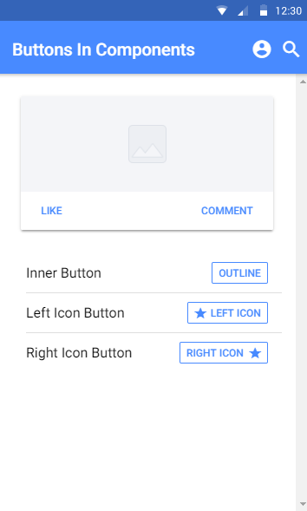

Combo-breaker Components
Why settle for one component when you can have more?
We can create our own super-components that work twice as hard
Not all components can be combined. “I could do this, but should I?” Let’s take a look at a quick example…

Slide 3
CHALLENGE TIME!
Think of the components we used so far in our app and how they might be combined
Mix it up a little and combine two components
For bonus points, try and combine a component we haven’t used yet (or even two components we haven’t used yet)!
Share a screen shot on our Discord Community and tell us why you wanted to mix those two together!

